Slide 1

RNA Biology in Hematological Tumors
R’n Blood
PI:
Dr. Stéphane Pyronnet, Ph.D. DR INSERM
co-PI:
Dr. Fabienne Meggetto, Ph.D. DR CNRS

Slide 2














Presentation of the Team
R’n Blood = a short history
Creation of &
Move to the CRCT
J.J. Fournié Director
S. Pyronnet Deputy Director
S. Guibert Adm Director
Renewal of
the CRCT
G. Favre Director
P. Cordelier Deputy Director
S. Guibert Adm Director
2009
2014
2021
2025
Team S. Pyronnet
« Protein synthesis & Secretion
in Pancreatic Tumors »
S. Pyronnet DR
C. Marboeuf Tech
Team S. Pyronnet DR, PI
F. Meggetto DR, co-PI
« R’n Blood »
skills
F. Meggetto DR
C. Touriol CR
M. Bousquet CR
L. Lamant PU-PH
S. Fuchs
L. Babin
C. Bessière
S. Dailhau
L. Colras
Post-Doc
Post-Doc
Post-Doc
I.E
I.E
Non-coding RNAs
CRISPR tech
Bioinfo
Bioinfo
Wet-lab
Team P. Brousset
« RNA Biology in
Hematological Cancers »
Team S. Mannenti
« Cell Cycle & Cancer »
L. Mazzolini CR
A. Gay IE
Recruits
E. Corre
C. Soum
E. Andraos
R. Pfeiffer
A. Zamani
Ph.D.
Ph.D.
Ph.D.
Ph.D.
Ph.D.
Fundraising 2019-2025: ~2.5 M€
(other than institutional)

Slide 3
R’n Blood
AML (Myeloid leukemia)
ALK+ ALCL (T-cell lymphoma)
Mostly >60 years (elderly)
Age
Mostly <20 years (pediatric)
FLT3, Kit, NRAS, KRAS
STAG2
RAD21
DNMT3A
IDH1/2
TET2
Sinaling
59%
others
Cohesin
13%
DNA
methylation
44%
SRSF2, U2AF1
SF3B1, ZRSR2
Splicing
14%
Genetic
alterations
Multiple
Few
TP53
Tumor
suppr
16%
Chomatin
modifiers
30%
ASXL1
EZH2
ALK⁺
NPM1-ALK 85%
BCR-ABL
RUNX1-RUNX1T1
KMT2A-re
…
Chr
transloc
18 %
NPM1
mutation
30 %
T. Factors
22 %
NPM1
RUNX1, BCOR, CEBPA
. Intensive Chemotherapy (Cyta + Dauno)
Therapeutic
options
. CHOP Polychemotherapy (CycloP+Anthra+Vinc+Pred)
. Targeted Therapy (FLT3, IDH, Aza+Ven)
. Targeted Therapy (anti-CD30, ALK)
. Allograft
. Allograft
~30% at 5 years
Survival
~70% at 5 years (ALK⁺)
issue = resistance

Slide 4
Scientific hypothesis - objectives
Deciphering new RNA-dependent (and druggable ?) regulatory mechanisms
involved in malignant transformation and/or resistance to treatment
Cap
AUG
mRNAs
Coding RNAs
+ variants
1
Cap
Deep RNA-Seq exploration of
whole transcriptome diversity
in large sample cohorts
3’-AAA
3’-AAA
miRNAs
Non-coding
regulatory RNAs
+ variants
2
circRNAs
AAA
lncRNAs
New
bioinformatics
pipelines
New RNA-dependent
mechanisms in
AML & ALK+ ALCL
Functional
studies
3
4

Slide 5
1
Large cohorts of deep RNA-Seq samples
AML
Disease sample cohort
ALCL
. IUCT DATAML:
. Beat-AML:
n = 200
n = 698
exploration
. IUCT:
n = 39
21 responders to ChemoT
18 refractory to ChemoT
. Leucegene:
n = 454
validation
n = 80
frozen tumors + blood samples
. IUCT PDX:
n = 20 +/- Cyta (Collab J.E. sarry)
. PDX:
n = 7
3 ALK Inhib resistant + 4 sensitive
Healthy samples
. HSC
. progenitors
. mature cells
BM
PBMC
. HEALTHY
n = 96
Cell lines
CCLE database
n = 1019
. Cell lines :
n = 37
. Cell lines : n = 9
. Including
n = 9 Parental/Cyta resistant couples
. Including
n = 7 Parental/ALK Inhib resistant couples
n = 2 Parental/ChemoT resistant couples

Slide 6
2
The transcriptome diversity of cancer cells
Non-genetic causes
Alternative promoter
E6a
E6
E7
E8
E9
E10
E11
Alternative poly(A)
E1
E2
E3
E4
E5
E6
E7
E8
I8
Canonical mRNA or lncRNA:
5’-cap-
E1
E2
E3
E4
E5
E6
E7
E8
E9
E10
E11
-AAAAA-3’
Genetic causes
Mutation
Alternative splicing
E1
E3
E4
E5
E6
E7
E8
E9
E10
E11
E6
E7
E8
E9
E10
E11
Translocation
E4
E5
circRNA
E3
E6

Slide 7
2
The transcriptome diversity of cancer cells
Non-genetic causes
Non-genetic causes
Alternative promoter
E6a
E6
E7
E8
E9
E10
E11
Alternative poly(A)
E1
E2
E3
E4
E5
E6
E7
E8
I8
Canonical mRNA or lncRNA:
5’-cap-
E1
E2
E3
E4
E5
E6
E7
E8
E9
E10
E11
-AAAAA-3’
Genetic causes
Mutation
Alternative splicing
E1
E3
E4
E5
E6
E7
E8
E9
E10
E11
E6
E7
E8
E9
E10
E11
Translocation
E4
E5
circRNA
E3
E6

Slide 8
3
New k-mer-based bioinformatics pipelines
Collaborations:
C. Marchet, CRISTAL, Lille
T. Commes, Bio2M, Montpellier
REINDEER
kmerator
Make requests possible via k-mers
Transipedia
Provides banks of Mutant vs Wild-type k-mers
Ex: n = 14,000 pairs of k-mers for 140 AML genes
R’n MUT
R’n Blood implementation
R’n SCAN
Identifies Seq-variants without a priori
. Quantitative
. Single nt resolution
. Unprecedented short time-frame
. Large cohorts
. Deep RNA-Seq

Slide 9
4
Example of a new non-genetic event in AML
Expressed in & Requiered for HSC
Calvanese et al. Nature 2019
MLLT3
E1
E2
E3
E4
E5
E6
E7
E8
E9
E10
E11
R’n SCAN
KMT2A::MLLT3
E6
E7
E8
E9
E10
E11
t(11;9)
One of the most frequent translocations in AML
Meyer et al. Leukemia 2023

Slide 10

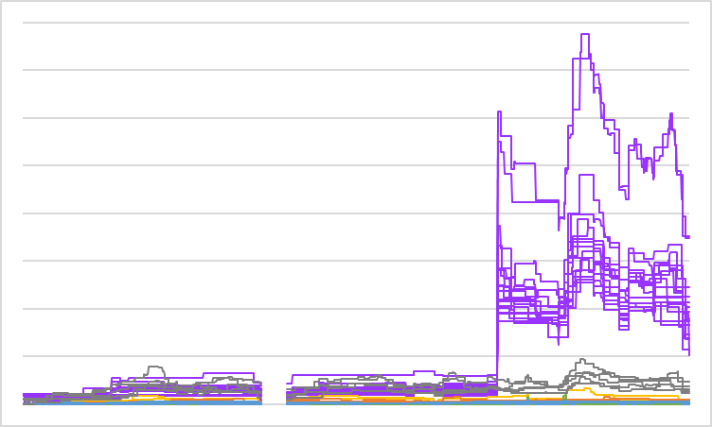
Scientific achievements
Bessiere et al. Cancer Commun 2025
1600
HSC (n = 17)
1200
Granulo
Mono
Number of reads
800
B cells
T cells
400
WBC
0
k-mers
(k=31)
n=1919
MLLT3 mRNA
1
2
3
4
5
6
7
8
9
10
11
MLLT3 protein
YEATS
AHD
low
n = 194
High
n = 42
. Alternative promoter
active only in HSC
6a
6
7
8
9
10
11
AML Survival
p=0,00027
AHD
. Active in ~20% of AML samples
. Independently of the KMT2A::MLLT3 translocation

Slide 11
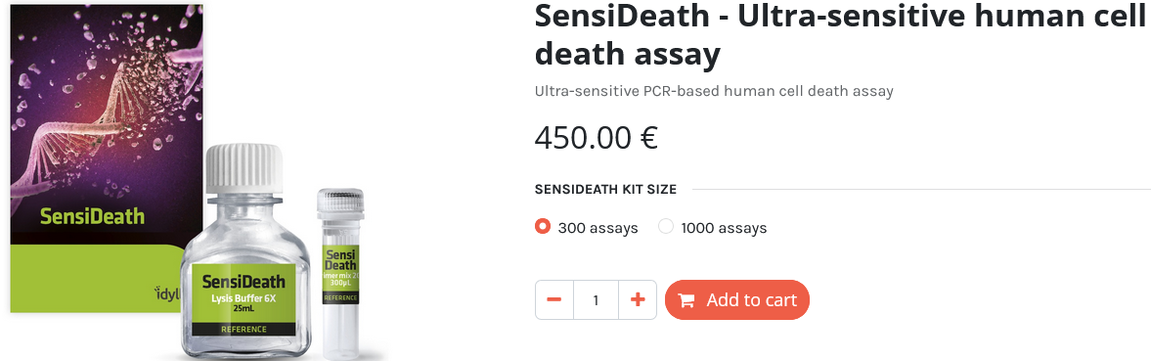
Scientific achievements
Main Publications
Main Productions
IF
> 10
> 5
Functional studies
Patents
20.1
Bessiere et al. Cancer Commun 2025
12.8
Philippe et al. Leukemia 2024
Corre et al. Sci Rep 2024
. # 21 305 467.9
Daugrois et al. Cancers 2021
“Methods for the treatment of ALCL”
12.8
Gourvest et al. Leukemia 2021
13.3
Congras et al. J Clin Invest 2020
. # WO2020188216 / FR2020/050571
8.2
Hoareau-Aveilla et al. Haematologica 2019
“Ultrasensitive method for cell death detection”
Technics-Bioinformatics
Licensed patents
Commercialized products
Bessiere et al. Methods Mol Biol 2025
10.1
Bessiere et al. Genome Biol 2024
Fuchs et al. PLoS One 2022
IDYLE LABS
Reviews
6.3
Babin et al. JCI Insight 2021
Féral et al. Biomolecules 2021
5.1
Jaud et al. Cells 2020
Andraos et al. Cancers 2021
Fuchs et al. Int J Mol Sci 2019
Gourvest et al. Cancers 2019

Slide 12



Trajectory 2027-2031
Deciphering new RNA-dependent (and druggable ?) regulatory mechanisms
involved in malignant transformation and/or resistance to treatment
Stéphane Pyronnet, DR-INSERM
Cap
AUG
mRNAs
Coding RNAs
+ variants
• mRNA translation in AML
Cap
Christian Touriol, CR-INERM
3’-AAA
• ER stress and translation in AML
3’-AAA
RDV tomorrow
morning
miRNAs
Marina Bousquet, CR-INSERM
Non-coding
regulatory RNAs
+ variants
• lncRNAs in AML
circRNAs
Fabienne Meggetto, DR-CNRS
AAA
lncRNAs
Laurence Lamant, PU-PH
• circRNAs in ALK+ ALCL
New RNA-dependent
mechanisms in
AML & ALK+ ALCL
Functional
studies
Industrial
partners:

Slide 13
SWOT
Strengths
• Expertise in RNA species/variants identification, quantification and functional characterization
• Strong interaction with clinicians and access to large& annotated patient cohorts
• Opinion leader group on ALCL in France and Europe
• Strong interaction with the socio-economic world
• Strong involvement in teaching
Weaknesses
• A young team that still needs to improve its production in order to raise its international profile.
• Team not yet competitive enough for European contracts
Opportunities
• Coupling new bioinformatics pipelines to patient data via AI and or machine learning for personalized medicine
• Targeting RNA for innovative therapeutics
Threats
• Institutional budget restrictions
• Institutional loss of technical staff, no lab memory
• Necessity of quick adaptation to the rapidly evolving field of non-coding RNAs
• Regulatory and ethical constraints for RNA-based therapeutics

